Slide 1
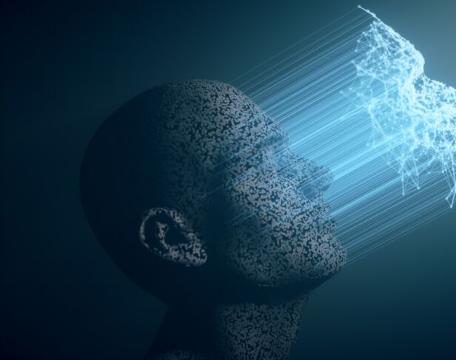

Facial Age and Gender Identification from Images
-Austin Varghese
Student ID: 11024612
Notes:
Hello professor and my classmates , my name is Austin Varghese , currently in the 2nd semester of my Master in Computer Science .The topic that I have chosen for my deep learning project is Facial Age and gender identification using CNN model .

Slide 2

Problem Statement and why I choose this Topic
Objective: There are several uses for the age-related data that may be derived from face photographs, ranging from biometrics to entertainment. Deciding the age of a face shot automatically is one of the most common and difficult tasks. It can be applied to various tasks, such limiting the media that a customer sees based on their age. Thus, the primary reason for the rise in popularity of facial feature analysis is that it is a practical tool, and advancements in Deep Learning techniques are making face analysis a reality rather than just a theoretical idea.
Importance: Facial age detection using images plays a vital role in Marketing and Advertising, Security and Surveillance, Healthcare, Human-Computer Interaction
Notes:
In today's digital age, the exponential growth of facial image data, fueled by the widespread use of cameras and the popularity of social media, has sparked a surge in research on autonomous age prediction from face images. With the abundance of visual data available, there's a growing interest in developing automated systems that can accurately detect age from facial photographs. This technology holds immense potential for practical applications in forensics, law enforcement, security control, human-computer interface, and various business sectors like retail and hospitality. However, age prediction presents unique challenges due to the complex and non-linear association between age and facial attributes. Factors such as emotions, surroundings, genetics, and lifestyle further complicate the task. Researchers are turning to advanced deep learning techniques, particularly convolutional neural networks (CNNs) and transfer learning, to improve prediction accuracy and reduce reliance on human intervention.

Slide 3

Literature Review
Research Paper 1: Age and Gender Prediction using Convolutional Neural Networks
This paper proposed a deep learning approach for age and gender prediction using convolutional neural networks (CNNs).
The authors collected a large dataset of facial images and used it to train their CNN model.
They achieved high accuracy in predicting both age and gender from facial images.
The model was able to capture important facial features related to age and gender, such as wrinkles and facial hair.
The authors concluded that CNNs are effective for age and gender prediction and can be used in various applications, such as facial recognition systems and age estimation in forensic investigations.
Research Paper 2: Deep Learning for Age and Gender Estimation: A Survey
This survey paper reviewed various deep learning techniques for age and gender estimation from facial images.
The authors discussed different approaches, including CNNs, recurrent neural networks (RNNs), and generative adversarial networks (GANs).
They analyzed the strengths and limitations of each approach and compared their performance on benchmark datasets.
The survey highlighted the importance of large and diverse datasets for training accurate age and gender prediction models.
The authors concluded that deep learning methods have shown promising results in age and gender estimation tasks, but further research is needed to improve their robustness and generalization capabilities
Notes:
These are the two papers that I have referred for my project . The literature on facial age detection encompasses various approaches, including traditional computer vision techniques and deep learning methods. Research focuses on developing accurate and robust models capable of estimating age from facial images, addressing challenges such as variations in lighting, pose, and facial expression.

Slide 4

Methodology Overview
Data Preprocessing
Model Architecture
Model Training
Performance Comparison
Work on improving performance of CNN model
Compare performance between pretrained model and CNN model
Notes:
CNN I will be implementing CNN fro this project architecture Flow chat for the process

Slide 5

Taks Done Till Now
Literature Review
Data Preprocessing
Notes:
So this is data preprocessing for my project .For data preprocessing in facial age detection, the images are standardized to a consistent format and size, ensuring uniformity across the dataset. Normalization of pixel values to a range between 0 and 1 is applied, and techniques like data augmentation may be used to increase the diversity of the dataset and improve model generalization.

Slide 6

Tasks in progress
How do the images look like in each of the classes .
What does the class distribution look like
Is there a class imbalance ?if yes ,how would we solve it
Is there a class imbalance ?if yes ,how would we solve it
What are multilayer perceptrons (MLP) and what are its drawbacks
.What is CNN ?
Conv2D and parameters
⁠types of activation functions. Check the differences between relu, leaky relu and softmax.
⁠why do we need batch normalization? How does batch normalization differ from Dropout?
⁠what are fully connected layers?
⁠which activation would you use for the classification layer of the neural network?

Slide 7

Project Timeline
Timeline | Things to be Done
Week 1-2 | Gather datasets
Week 3-4 | EDA – Exploratory Data Analysis
Week 5-6 | Create CNN model
Week 7-8 | Work on improving performance of CNN model
Week 9-10 | Run Inference using pretrained model
Week 11-12 | Compare performance between pretrained model and CNN model
Timetable:

Slide 8
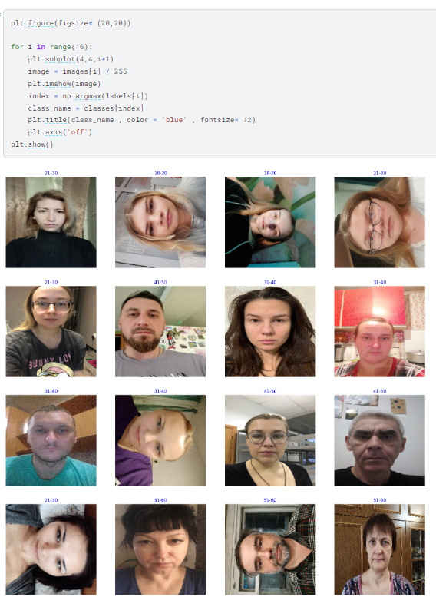

Conclusion
Facial Image recognition using images can be used in multiple applications such as:
Marketing and Advertising. Security and Surveillance. Healthcare. Human-Computer Interaction.

Slide 9


THANK YOU

